Slide 1

CPS 584 Final Project
By :
Vignesh Yanamalamanda
Sai Sreeja Tatineni

Slide 2
Introduction
Project Goal
To generate Facial Images from Text
To generate Audio from Text
To replicate Audio from Source Audio Given
Finally, Combine the Audio and Image - To make Video of Talking Head

Slide 3
Technologies and Tools Used
We approached so many ways but most of them did not work well yet we came up new way
We used several available models :
Stable Diffusion( For Image Generation)
Parsel, Whisper( Text to Speech and Target Audio Speech)
SadTalker/ Halo/ Dreamtalker( For Lip Syncing)
We Used Python, Google Colab, Gradio and Hugging Face

Slide 4
Workflow
Load an Image or Generate Image from Text
Load Audio file or Generate Audio from Text or Clone Voice from sample and Generate Audio
Generate Talking Portrait

Slide 5
High-Level Diagram
Let User Upload an Image
or Generate From Text
Let User Upload Audio file
or Generate Audio from Text
or
Generate A clone voice
Animate the image and audio into a video, accessible to play and download
Step 1:
Image Generation
Step 2: Audio Generation
Step 3:
Talking Portrait

Slide 6
Image Generation
If User Prompts for an Image
then We need to Generate Image
For That We Used API of
Stable Diffusion XL-Lighting
Also for Step 3 : It needs to be 256 px of resolution, also it only takes .png files

Slide 7
Function to generate Image
function name : Generate_Portrait(Prompt)
Returns : ready_png
Note: ready_png is generated by check_and_convert_webp_png function

Slide 8
OTHER FUNCTIONS
We have created other significant functions to perform designated tasks and helper functions.
For use of them and naming, Please refer to the file
app.py

Slide 9
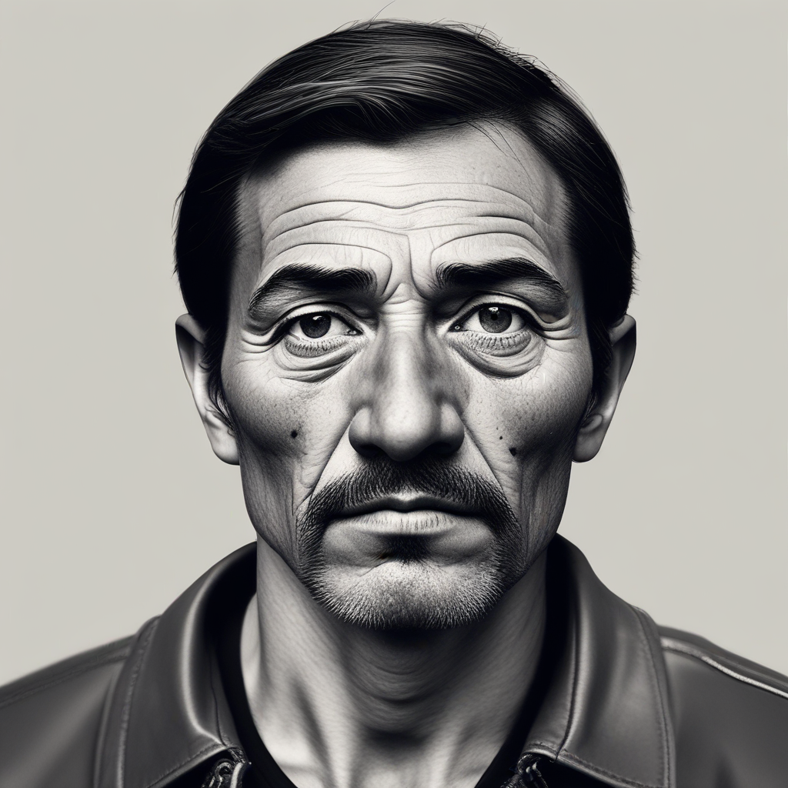
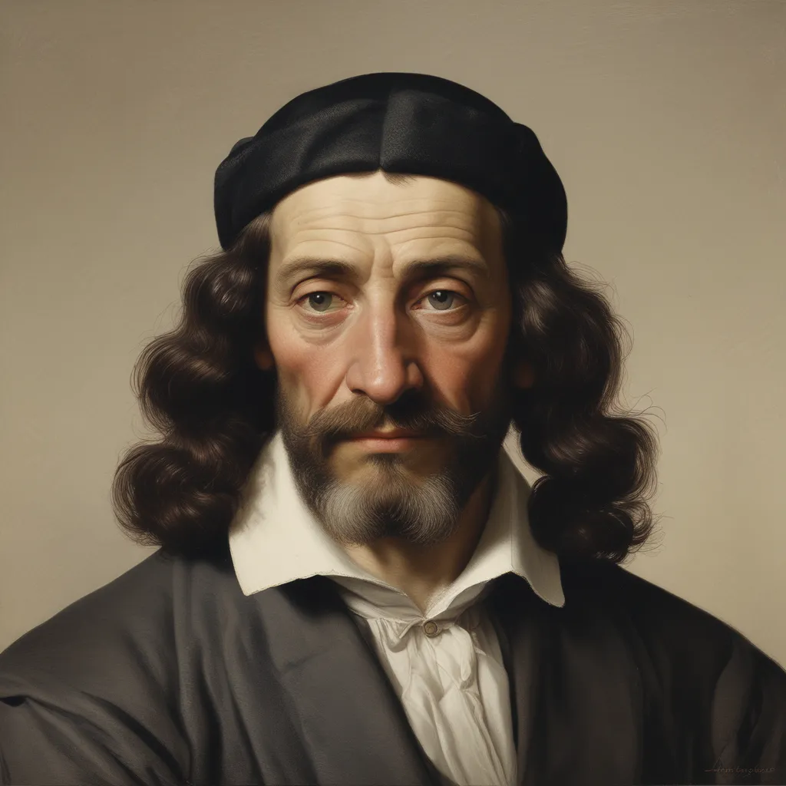
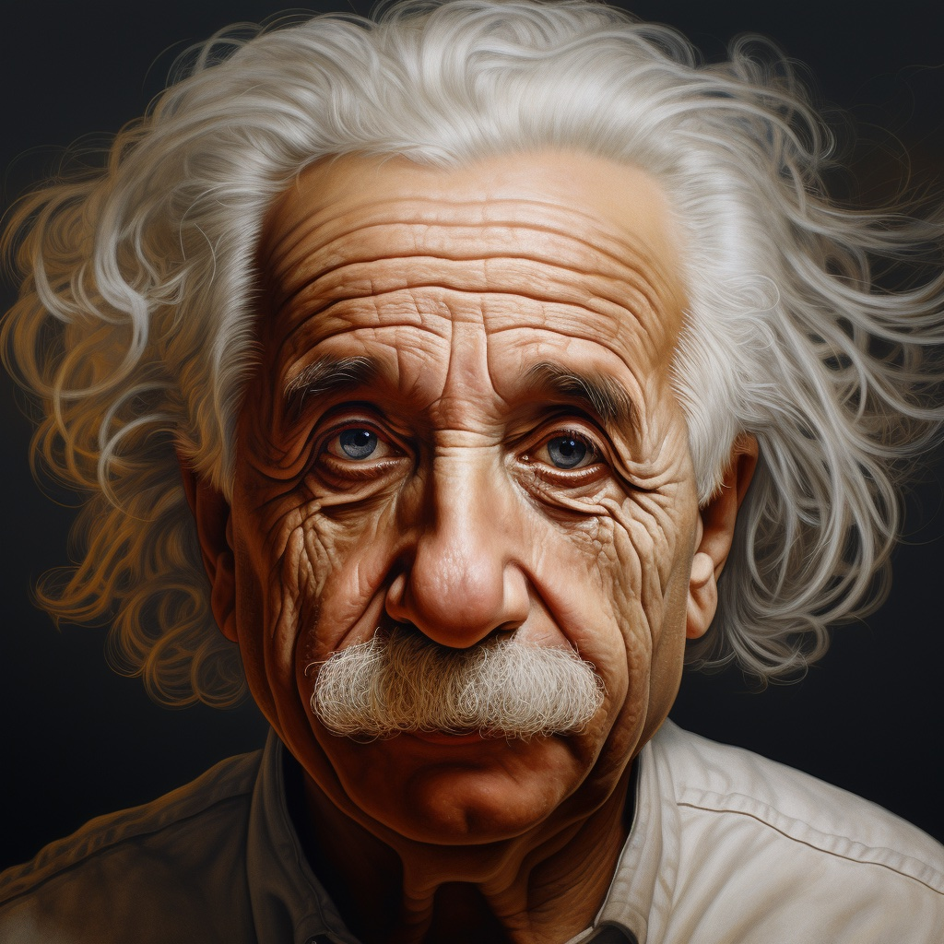
Prompt : Face of a Man

Slide 10
Audio Generation
1. With Parler TTS
We used Parler TTS to Generate Audio from Text
Prompt : Hello, This is a Test Project

Slide 11

Output Generated

Slide 12
Generating Talking Portrait
Now we combine both Image and Audio to function called pipe
which will create talking head video

Slide 13
Publishing as an APP
As Requirement, We tested the project on Google Colab and Then Used Gradio to Generate UI based site running locally, but everytime it had load on the GPU and Took longer time.
So We Published the Project on HuggingFace Website. HuggingFace Website is a platform for supporting ML Applications for Free and Premium bases

Slide 14
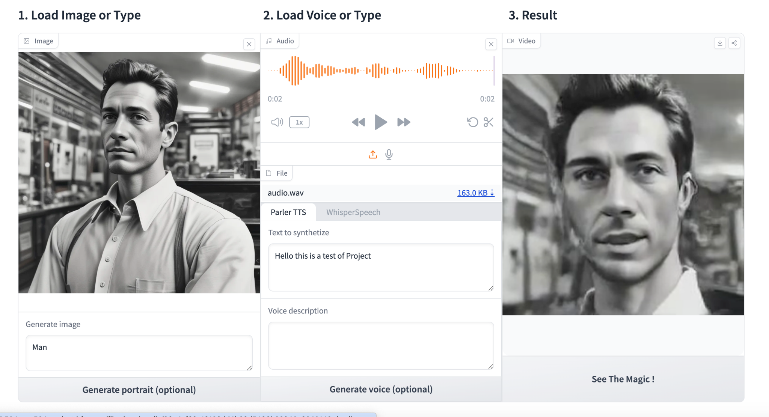
UserInterFace

Slide 15
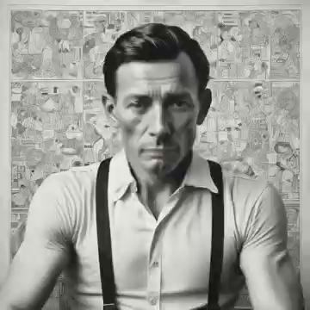
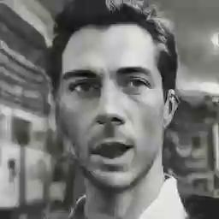
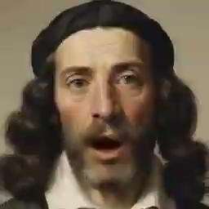
Result and Outputs

Slide 16
Issues Faced
Though it seems Simple, There were Problems We Faced a lot for achieving this target. .API’s don’t work Seamless with Hardware using for the project.
. On google Colab, time elapsed for too long
.Side facing Images won’t give best results

Slide 17
Takeaways
Project is not impossible to achieve but needs access to More TPUs to Process for even smaller Files
Project can be optimised and greater potential to use in variety of ways

Slide 18
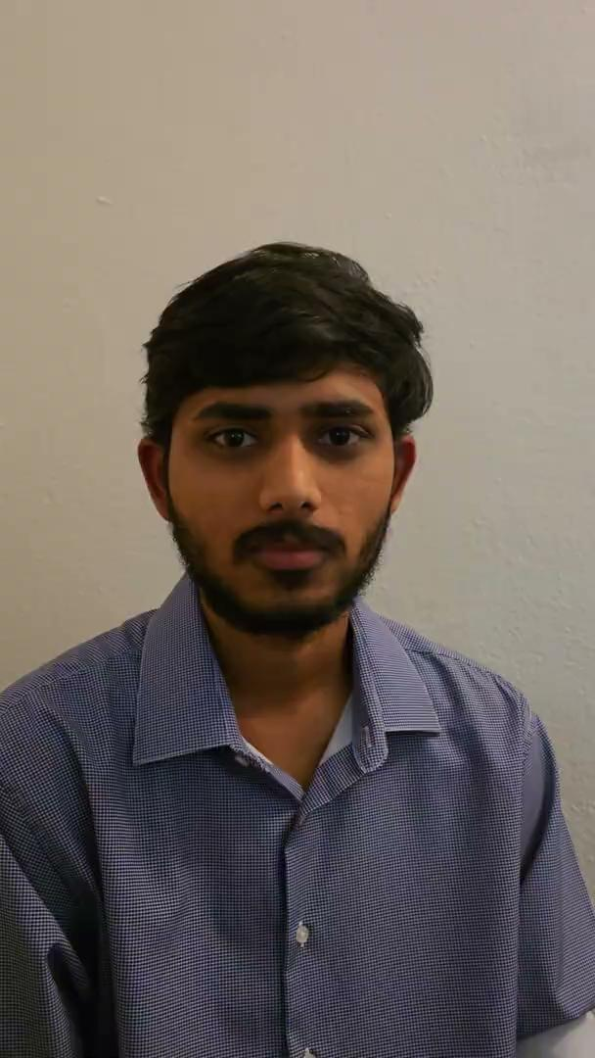
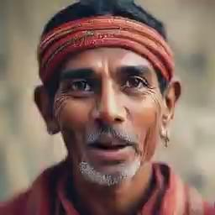
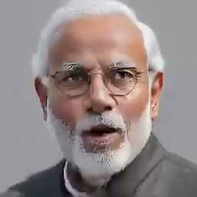
McGurk Effect
perceptual phenomenon that demonstrates an interaction between hearing and vision.

Slide 19
Acknowledgement
Thanks to Prof. Mehdi R. Zargham for Teaching and Inspiring us to Pursue creativity in Deep Learning and Machine Learning.

Slide 20
Links to The Project
https://github.com/Vignesh584/CPS584_Project
Working App:
https://huggingface.co/spaces/vignesh584/CPS584_Project

